Slide 1
Efficiency of NYC's Taxi System
Fatima Chebchoub - NYC College of Technology
Abraham Neuwirth - Touro College
Jai Punjwani - Adelphi University
Marieme Toure - NYC College of Technology
Notes:
Test notes

Slide 2
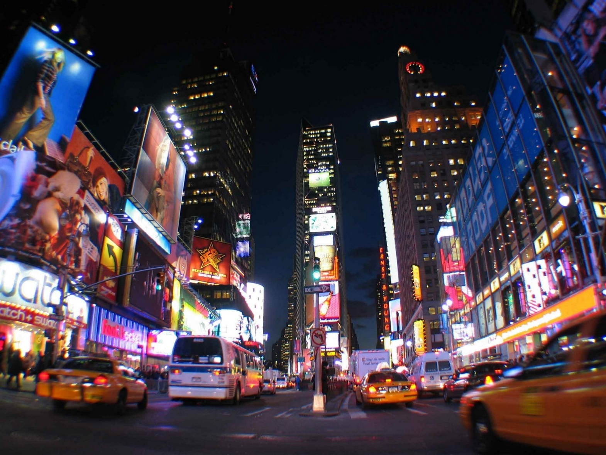
NYC's Taxi System

Slide 3
Research questions
Can we understand traffic flow in the city?
Can we understand drivers and analyze how efficient they are?
Can we use this information to improve the taxi transportation system in NYC?

Slide 4
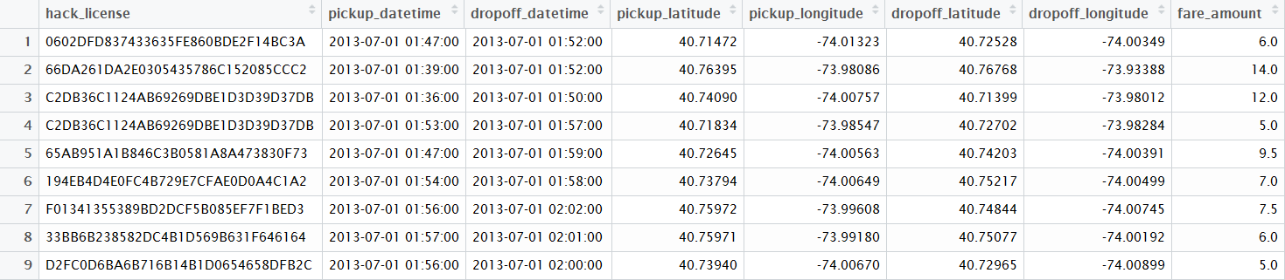
2013 Yellow Taxi Data Set*
~ 13 million rides in July 2013
~ 150 million rides every year
*Source (http://www.andresmh.com/nyctaxitrips)

Slide 5
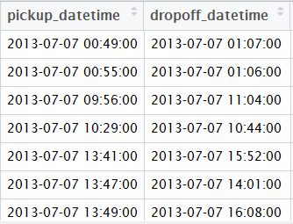
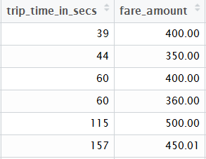

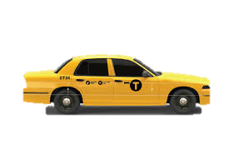
Data cleaning
Bizarre Coordinates
Simultaneous trips
Fishy Drivers
Notes:
(0 second trip charged, start/end same)

Slide 6
What is the typical “flow” of the city?
Set up the idea of measuring neighborhood flows
Cite any related work

Slide 7
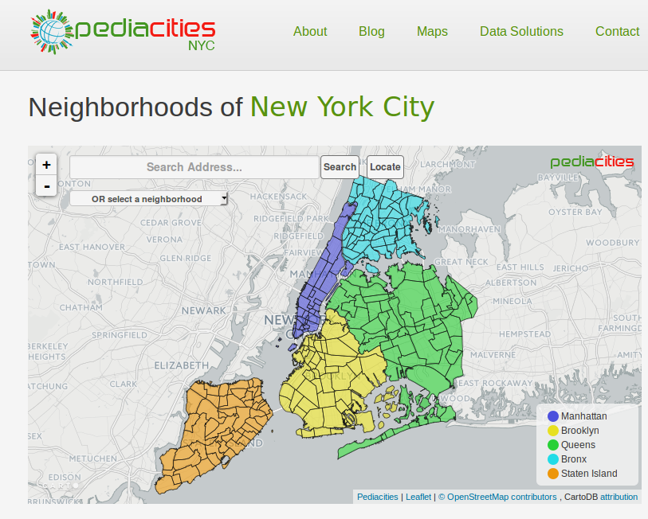
Mapping trips to neighborhoods
Data is recorded in geographical coordinates
10 million latitude/longitude pairs
"Shapefiles" define boundaries for 266 Neighborhoods
Helped us weed out nonsensical data entries

Slide 8
A typical weekday
"Hot" neighborhoods: many people enter, few leave
"Cold" neighborhoods: few enter, many leave
“Neutral” neighborhoods: same amount entering and leaving
Neighborhoods score reflects net people in that neighborhood at any given time

Slide 9
Popular / unusual destinations
Explain how we compute neighborhood to lat/long trip popularity
Compare to overall
Show most popular and most unusual destinations for one or two neighborhoods

Slide 10
Shiny app
Screenshot + url

Slide 11
Driver Efficiency
Is the amount a driver makes due to chance?
Analyzed the behavior of the drivers and classified them as good or bad drivers
Defined efficiency
Made some predictions

Slide 12
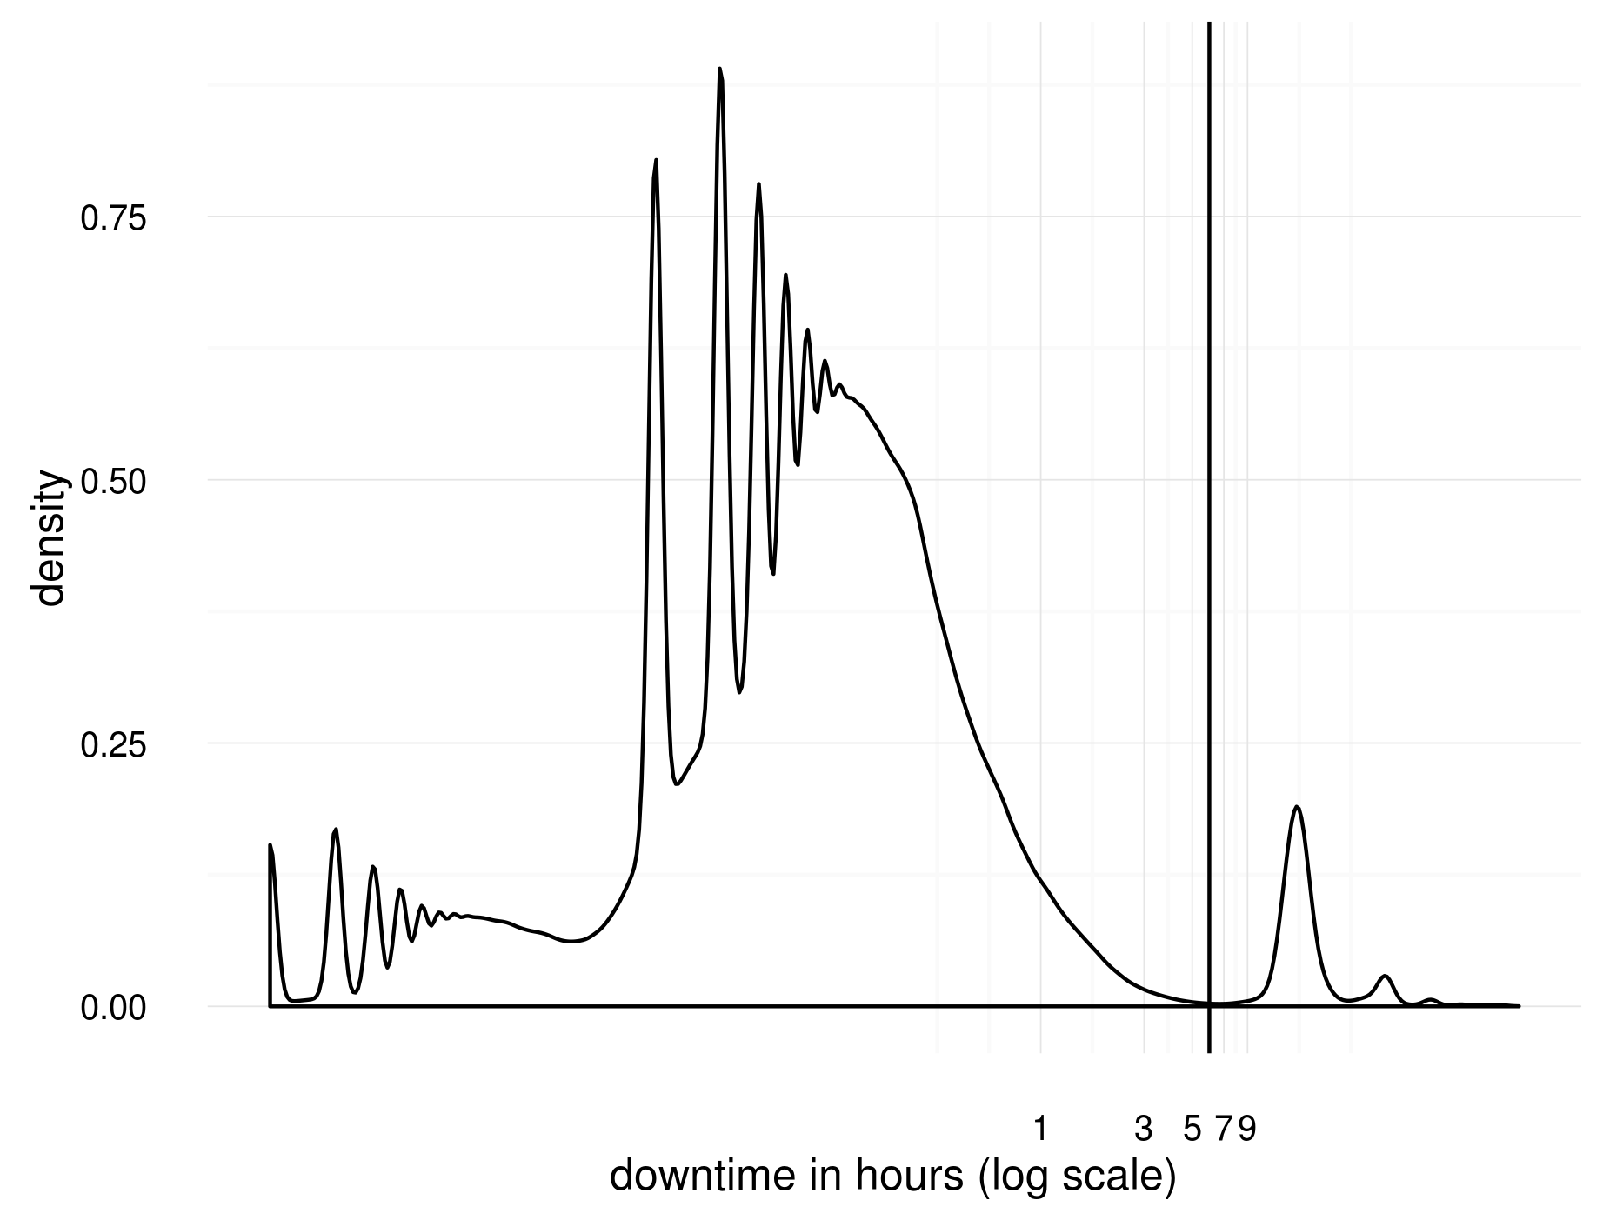
Identifying shifts
Shift definition is somewhat subjective because it is based on the available data

Slide 13
Definition of Efficiency
Efficiency = Total fare amount($) / Shift length(hour)
Total fare amount = $2.50 + fare amount (does not include tax and tips)

Slide 14
Shifts Based
10 Random good driver
10 Random bad driver

Slide 15
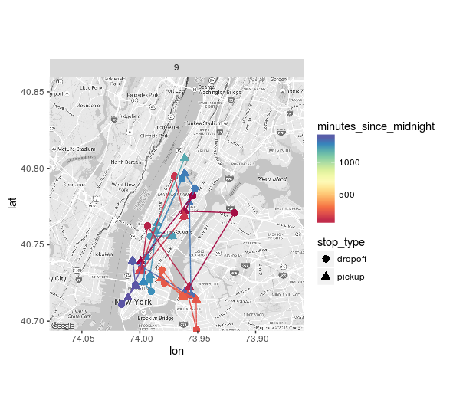
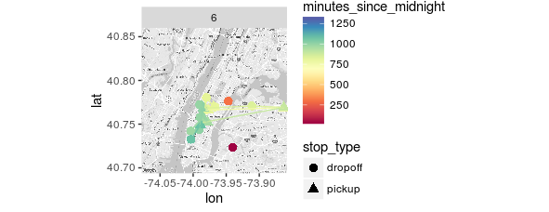
Extreme Drivers
High earning driver
Low earning driver

Slide 16
Extreme Drivers Stats
Start | End | Fare | Total Trips | Trip Time | Trip Distance | Efficiency
July 10th, 16:02:13 | July 11th, 02:02:17 | 747.5 | 18 | 18230 | 107.7 | 74.74
July 12th, 16:55:23 | July 13th, 01:17:21 | 361.0 | 24 | 20897 | 100.8 | 43.15
Start | End | Fare | Total Trips | Trip Time | Trip Distance | Efficiency
July 10th, 6:28:00 | July 10th, 12:38:00 | 173 | 17 | 12729 | 32.57 | 28.05
July 13th, 7:22:00 | July 13th, 11:50:00 | 106 | 8 | 7890 | 29.62 | 23.46

Slide 17
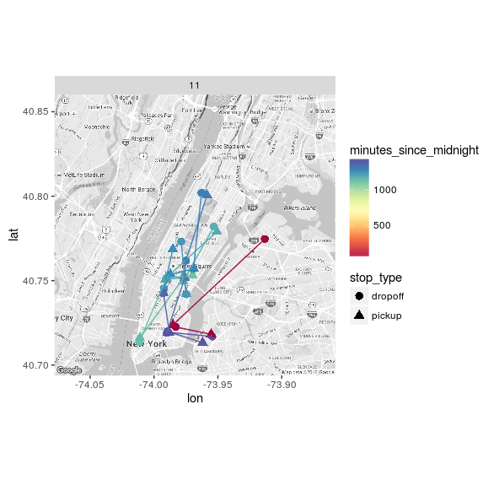
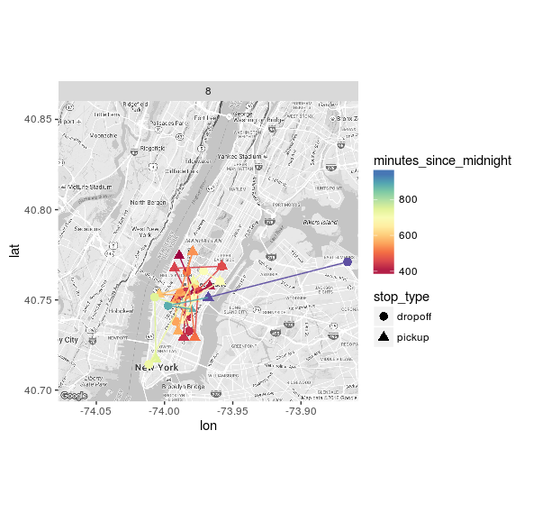
Guessing Game

Slide 18
Can we predict efficiency?
Regression Model includes the following features:
Start hour,
Weekend / Weekday
Precipitation
Average trip time
Average trip duration
All pickups and dropoffs locations

Slide 19
Efficiency Prediction
RMSE (for shuffled drivers) = $5.75 / hour
RMSE (for non-shuffled drivers) = $4.57 / hour
This difference in the RMSE values confirms the correlation between driver and efficiency

Slide 20
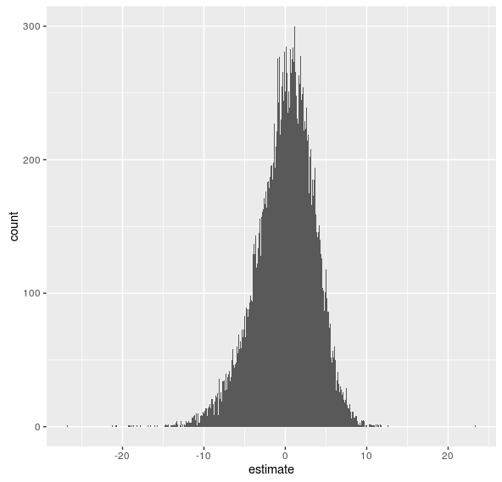
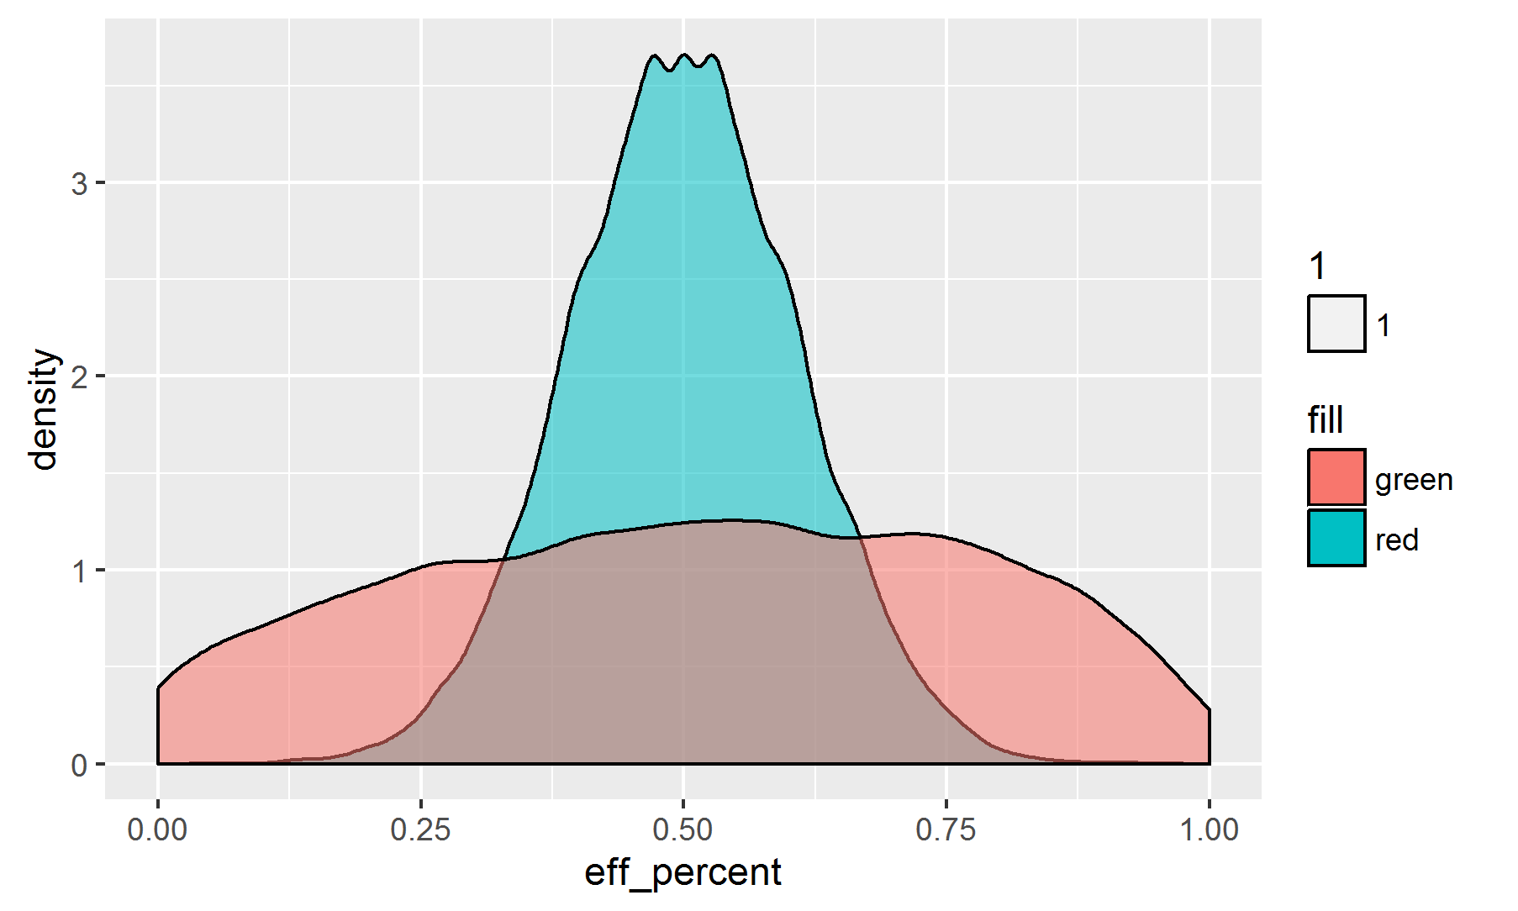
Drivers' Distribution

Slide 21
Q3: Can we improve efficiency of the taxi system?
Efficiency of drivers + the flow of trips
Efficiency of the system (and passengers)

Slide 22
Carpooling:
Carpooling Helps Save You Money
Carpooling Helps the Environment
Carpooling reduce the traffic

Slide 23
Carpooling is not a new phenomenon
City tried in 2009 two "carpooling" stands, but failed because people in that area.
Matthew Daus, the TLC commissioner at the time, said, “It’s a chicken-and-egg thing. New Yorkers want to go somewhere real quick, they don’t want to wait two seconds for another passenger, and the cab drivers don’t want to wait—time is money.”

Slide 24
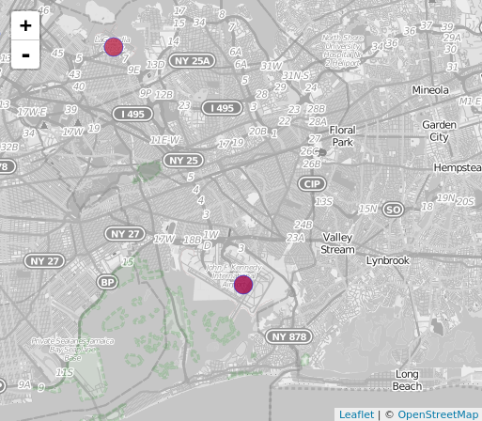
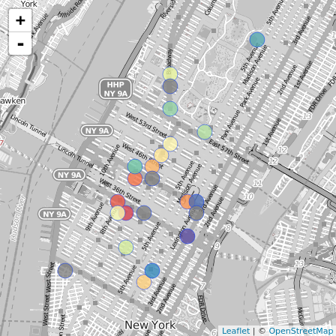
Identifying carpooling hotspots
Source neighborhood # destination neighborhood

Slide 25
Carpool savings
min_cabs = ceiling(total_psgrs / max_psgrs_per_car) min_fare = avg_fare * min_cabs min_fare_per_psgr = min_fare / total_psgrs cabs_savings = num_trips - min_cabs fare_savings = total_fare - min_fare fare_savings_per_psgr = fare_per_psgr - min_fare_per_psgr
we can improve the system by about 3-10%

Slide 26
Conclusions
Summarize what we did / found
Suggest some ideas for future improvements

